Slide 1

AI
and
PRIVACY CONCERNS

Slide 2
AI in the Digital Age
Artificial Intelligence (AI) refers to the simulation of human intelligence in machines that are programmed to think and learn like humans. AI systems can process information, learn from it, and make decisions based on that knowledge, mimicking human cognition.
Applications of AI in Today's Life:
1. Virtual Assistants: AI-powered virtual assistants like Siri, Alexa, and Google Assistant help users with tasks, answer questions, and provide information.
2. Recommendation Systems: Platforms like Netflix, Amazon, and YouTube use AI algorithms to recommend movies, products, and videos based on user preferences.
3. Social Media: AI analyzes user behavior and content to personalize social media feeds, showing relevant posts and advertisements.
4. Chatbots: Many websites and apps use AI-driven chatbots to provide instant customer support and answer user queries.
5. Smart Home Devices: Devices like smart thermostats and security cameras use AI to adapt to users' routines and enhance home automation.

Slide 3
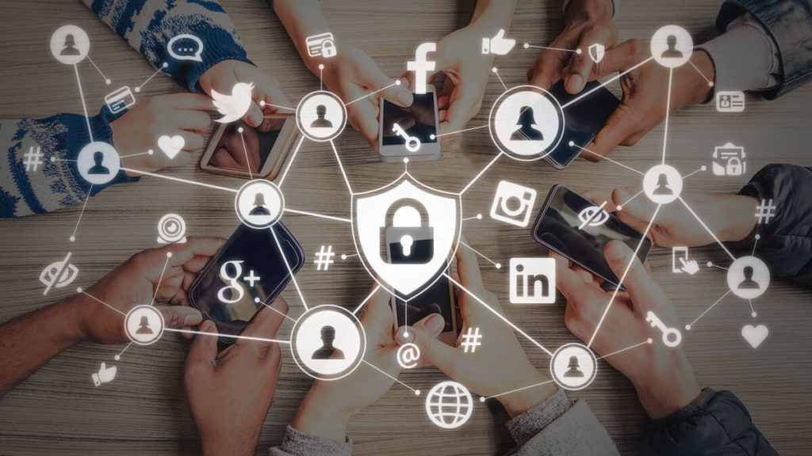
Understanding Privacy in Digital Age
Privacy is the fundamental right that grants individuals control over their personal information, both offline and online. It safeguards sensitive data, ensuring confidentiality and protecting against identity theft, financial fraud, and cybercrimes. In the digital age, privacy enables freedom of expression, fosters trust in online interactions, and upholds ethical standards in data handling. It is the assurance that our digital activities remain secure, private, and under our control.
Importance of Privacy
Personal Security: Protects against identity theft, fraud, and cybercrimes.
Trust and Confidence: Builds trust, encouraging secure online transactions.
Freedom of Expression: Fosters open communication without fear of surveillance.
Ethical Responsibility: Upholds ethical data handling and user consent.
Legal Compliance: Adhering to privacy laws ensures legal and ethical practices.
Psychological Well-being: Reduces stress and anxiety related to digital interactions.
Innovation and Autonomy: Encourages creativity and preserves individuals' control over personal data.

Slide 4
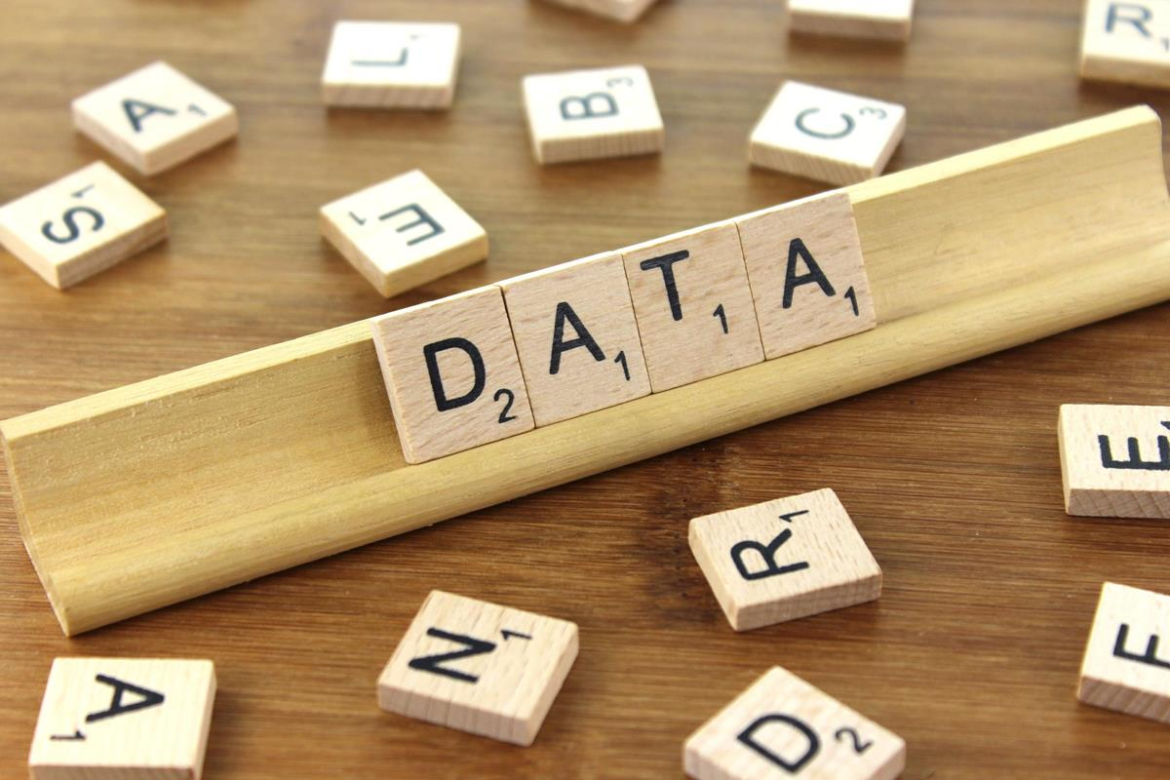
AI and Data Collection
How AI Systems Collect and Process Data:
Data Mining: AI systems use algorithms to analyze vast amounts of data, extracting patterns and insights.
Machine Learning: AI learns from data patterns, allowing systems to improve predictions and decisions over time.
Natural Language Processing: AI interprets and generates human language, facilitating communication and understanding.
Sensor Technologies: Smart devices use sensors to collect real-time data, enabling AI-driven responses and actions.
Web Scraping: AI extracts data from websites, often used in market research and content aggregation.
AI Applications Involving Data Collection:
Social Media Platforms: AI analyses user behaviour, preferences, and content to personalize feeds and target ads.
Smart Home Devices: Devices like smart thermostats collect user habits for energy efficiency and user comfort.
Healthcare Systems: AI processes patient data for diagnostics, treatment suggestions, and medical research.
E-commerce Platforms: AI algorithms analyze purchase history to offer personalized product recommendations.
Location-Based Services: AI uses GPS data to provide location-specific information and services.

Slide 5
Privacy Concerns in AI
Overview of Privacy Concerns Related to AI Technologies:
Data Surveillance: AI systems continually observe and analyze user data, raising concerns about constant monitoring and intrusion into personal lives.
Data Breaches: AI-driven systems can be vulnerable to cyber-attacks, resulting in significant data leaks that compromise individuals' privacy and security.
Identity Theft: Advanced AI algorithms can create convincing fake identities, increasing the risk of identity theft and various fraudulent activities.
Discussion on Surveillance, Data Breaches, and Identity Theft:
Data Surveillance: AI-powered surveillance tools, such as facial recognition, can track individuals without explicit consent, posing threats to personal privacy.
Data Breaches Impact: Hacked AI systems lead to financial loss, reputational damage, and emotional distress for affected individuals, eroding their sense of privacy and security.
Identity Theft Risks: AI analyzes online behavior, enabling the creation of realistic fake identities and intensifying the threat of identity theft.

Slide 6

Ethical AI Development:
Transparency: Ensure openness about data usage and algorithmic processes to build user trust.
Privacy: Prioritize user data protection, implementing stringent measures to safeguard sensitive information.
Fairness: Mitigate biases in AI algorithms to ensure equal treatment for all users, regardless of demographics.
Accountability: Establish clear accountability structures for the outcomes of AI decisions, fostering responsible development and usage.
Security: Implement robust cybersecurity protocols to protect AI systems from unauthorized access and cyber threats.

Slide 7
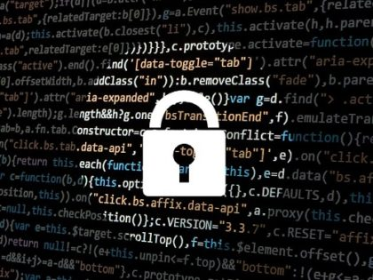
Privacy-Preserving AI Technologies
Privacy-Preserving Techniques:
Federated Learning: This technique allows AI models to be trained across multiple devices or servers holding local data samples without exchanging them, ensuring user privacy is maintained.
Homomorphic Encryption: Homomorphic encryption enables computations on encrypted data, allowing AI algorithms to process sensitive information without decrypting it, thus safeguarding user privacy.
Differential Privacy: Differential privacy adds noise to individual data points, ensuring that the presence or absence of specific data doesn't impact the overall analysis, thereby protecting individual user privacy.
How These Technologies Protect User Privacy:
Data Localization
End-to-End Encryption
Anonymization
Controlled Access
Secure Computation

Slide 8

Case Study: Facebook Cambridge Analytica Scandal
Event: Facebook Cambridge Analytica scandal in 2018 revealed a massive data breach, compromising privacy on social media platforms.
Data Harvesting: Approximately 87 million Facebook users' data collected without explicit consent, sourced through a quiz app and their friends' data.
Misuse: Data misused for political purposes, influencing opinions and voting behavior in events like the 2016 U.S. presidential election and the Brexit referendum.
Lessons Learned:
Transparency: Need for transparent data practices, ensuring users know how their data is used.
Informed Consent: Emphasis on obtaining informed user consent before accessing or sharing data.
Third-Party App Permissions: Reevaluation of lax policies, tightening regulations to enhance user data protection.
Impact: Led to increased vigilance among companies, initiating regular privacy audits and ethical oversight to prevent unauthorized access and data misuse.
Importance: Highlighted the crucial need to safeguard user trust and privacy rights in the digital age.

Slide 9
Balancing Innovation and Privacy
Ethical Development: It's crucial to develop AI technologies ethically, ensuring that innovation aligns with user privacy rights. Ethical considerations should be integrated into the core of AI development processes.
Transparency: Companies must be transparent about their data usage practices. Users should have clear insights into how their information is collected, processed, and utilized by AI systems. Transparency builds trust and informed user consent.
Regulatory Frameworks: Governments play a pivotal role in creating and enforcing robust privacy regulations. Clear and comprehensive regulations set standards for AI applications, ensuring the protection of user privacy while promoting innovation.
User Education: Individuals need to be aware of their privacy rights in the digital landscape. User education is vital; people should make informed decisions about the technologies they use and understand the implications of sharing their data. Informed users are empowered users.

Slide 10

Tips for Protecting Personal Privacy
Strong Passwords
Regular Software Updates
Caution with Personal Information
Two-Factor Authentication
Privacy Settings
Phishing Awareness
Regular Data Audits
Secure Wi-Fi
Safe Browsing Practices

